Slide 1









EMPLOYEE EXPERIENCE
WEEK
JUNE- 2025

Slide 2




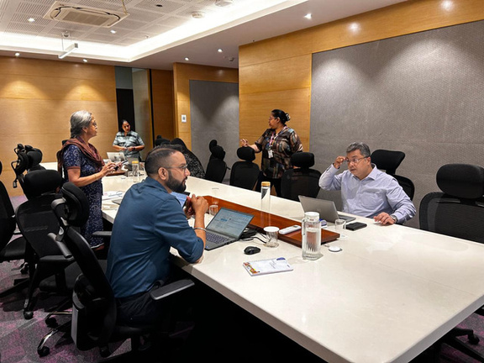
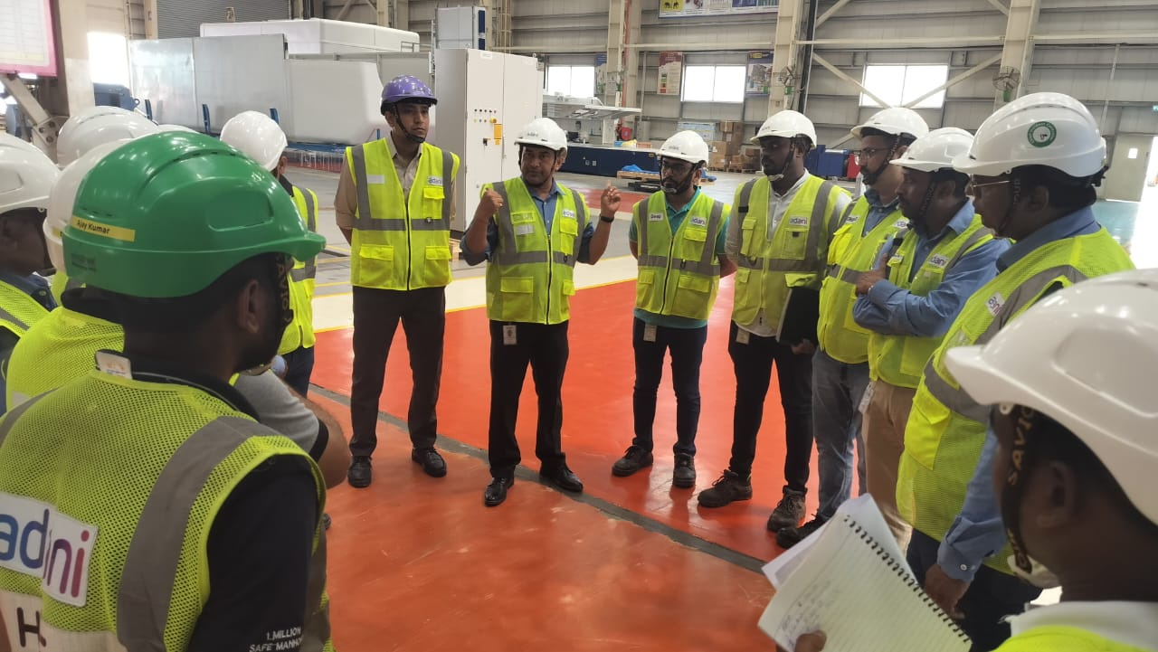
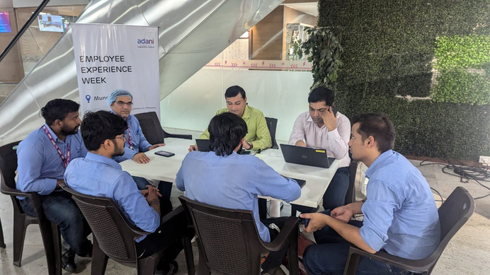



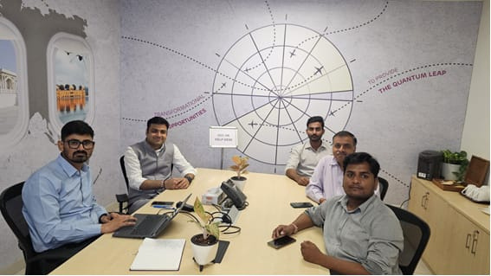
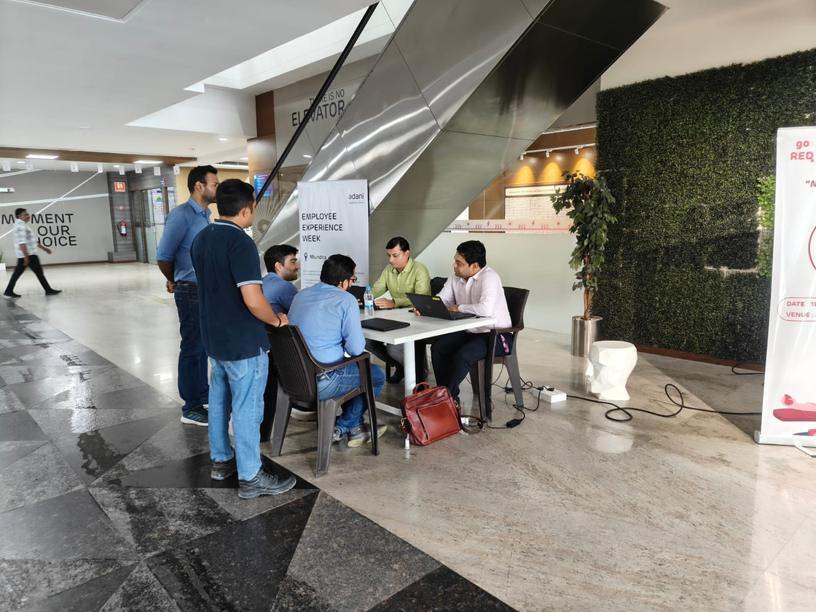
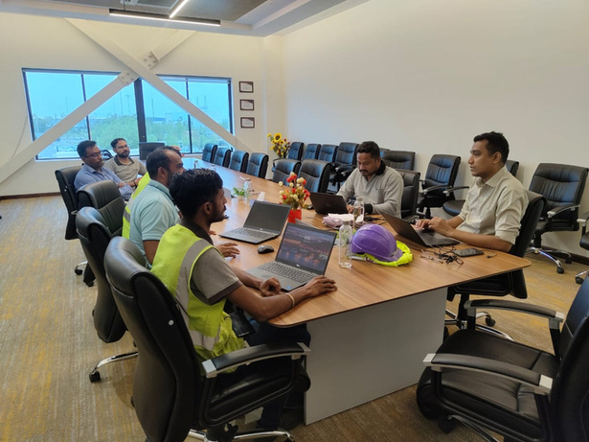
GLIMPSES FROM EMPLOYEE EXPERIENCE WEEK

Slide 3
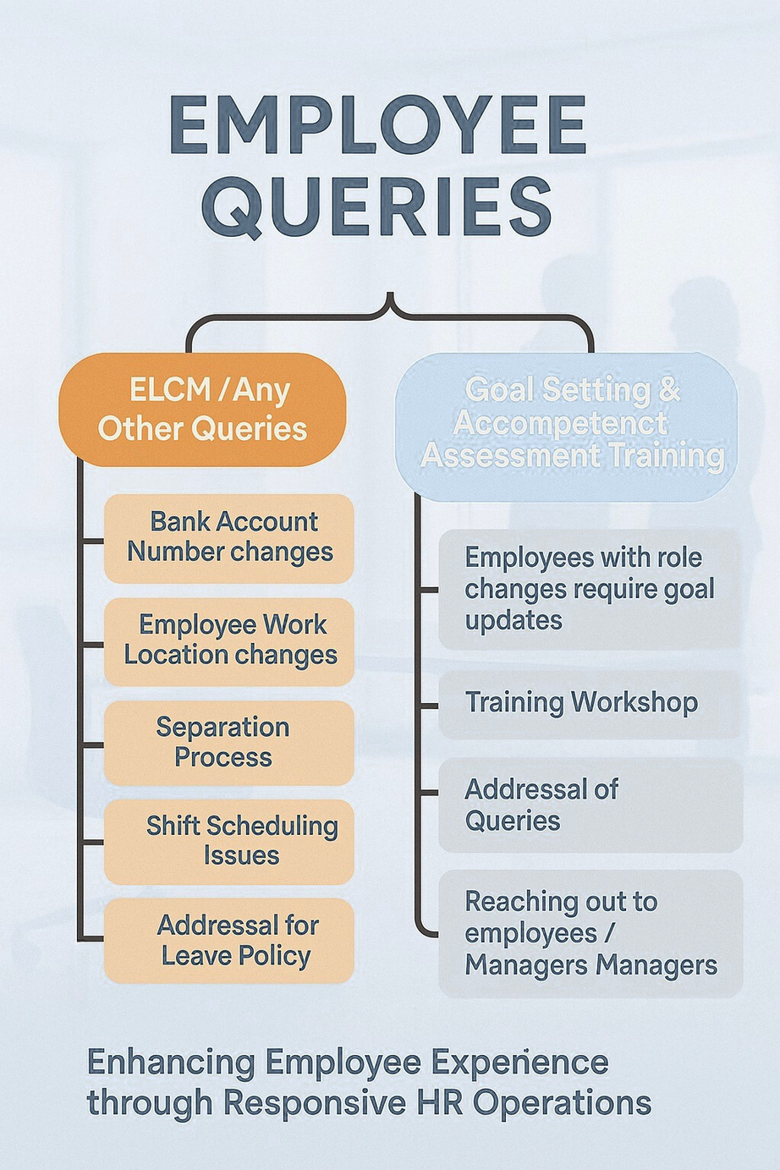



EMPOWERING EMPLOYEES THROUGH CLEAR, TIMELY HR SUPPORT
The Employee Experience sessions effectively captured and addressed common queries such as work location changes, shift scheduling issues, and leave policies. Additionally, the initiative supported role transitions through goal-setting workshops and direct engagement with employees and managers — reinforcing responsive and employee-centric HR operations.

Slide 4

DRIVING EMPLOYEE-CENTRIC ENGAGEMENT THROUGH EXPERIENCE KIOSKS
Conducted kiosks across 20+ Adani locations between 16–24 June
Enabled direct employee interaction — both offline & online modes
Focused on surfacing real-time queries and resolving them on the spot
Reinforced our people-first approach through transparent dialogue

Slide 5
UNDERSTANDING & ACTING ON EMPLOYEE PRIORITIES
Addressed key queries on policies, payroll, training, ELCM, and shifts
Created structured feedback loops around employee concerns
Tracked common pain points for future strategic HR improvements
Acted as both resolution centers and listening posts for deeper insights

Slide 6
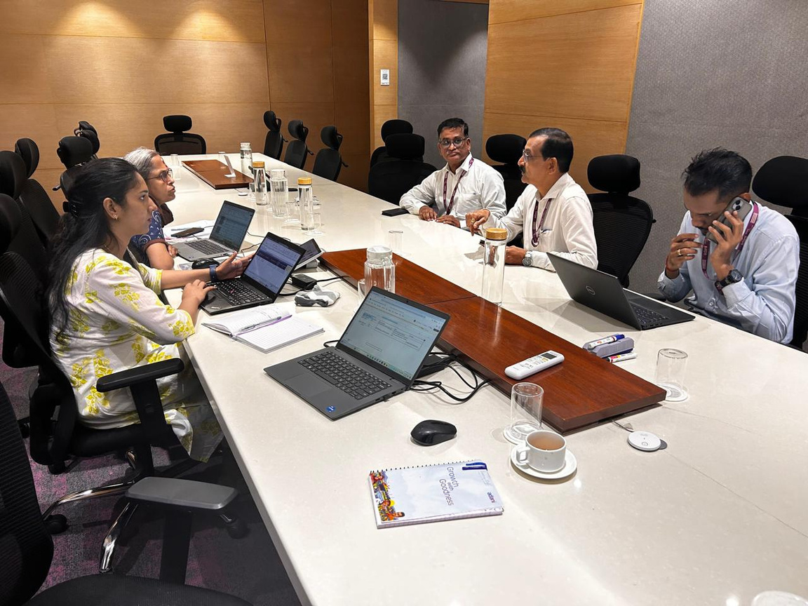
BUILDING TRUST THROUGH RESPONSE-DRIVEN HR OPS
85%+ queries resolved in the duration of 16-24 June
High resolution where SPOCs were aligned and present
Identified recurring gaps in Mediclaim, shift & comp-off awareness
Sessions reinforced trust, transparency, and proactive HR delivery

Slide 7


THANK YOU

